Slide 1
Everything I know about BFS/DFS
Russell Zhu

Slide 2
Disclaimer :)

Slide 3
What I’m not going to talk about
Big Oh Omega and Theta
Space vs time complexity
Advantages and limitations between graph vs tree search, BFS vs DFS vs…
When each algorithm fail

Slide 4
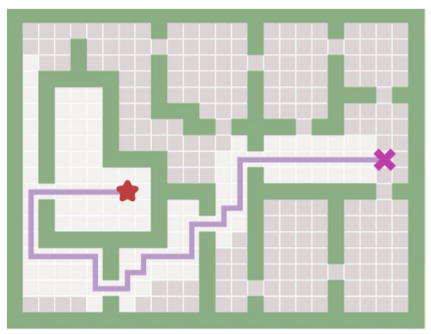
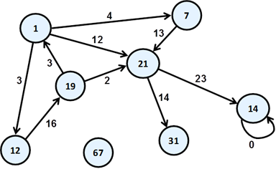
To get you thinking

Slide 5
Potential use cases
Searching for the shortest/ longest path
Search if there is a path between 2 nodes
Searching if a node is contained in the graph/tree

Slide 6
Quick summary of prereq knowledge
Queue
Stack
Set
Priority Queue
Graphs vs Trees

Slide 7
What is BFS/DFS
Algorithms that specify how to search
Graph search algorithms
Use a fringe/frontier

Slide 8
Compare
Breadth First Search
Search each level first
Implemented with queue
Graph/Tree variant
Depth First Search
Search to the deepest level
Implemented with stack
Graph/Tree variant

Slide 9
General Implementation
Tree Search
INITIALIZE fringe
LOOP through condition
TAKE a node out of the fringe
IF it’s the goal state then return
ELSE add expanded nodes to fringe
END
Graph Search
INITIALIZE open and closed fringe
LOOP through condition
TAKE a node out of the fringe
IF it’s the goal state then return
ELSE add node to closed fringe and
add expanded nodes to open fringe
END

Slide 10
BFS vs DFS Specifics
Breadth First Search
INITIALIZE queue
LOOP through condition
DEQUEUE a node out of the queue
IF it’s the goal state then return
ELSE enqueue expanded nodes
END
Depth First Search
INITIALIZE stack
LOOP through condition
POP a node out of the stack
IF it’s the goal state then return
ELSE push expanded nodes
END

Slide 11
Other cool stuff
Iterative Deepening DFS
Uniform Cost Search (UCS) - backward cost
Dijkstra's Algorithm
Greedy Search - forward cost
A*

Slide 12
Try it out yourself
Shortest path https://open.kattis.com/problems/buttonbashing
Generate graph from input https://codeforces.com/contest/796/problem/D
Shortest path with walls https://codeforces.com/contest/877/problem/D
https://codeforces.com/contest/60/problem/B
https://codeforces.com/contest/884/problem/C
https://codeforces.com/contest/60/problem/C

